Slide 1

COBO AI
"EXPANDS CONTEXT WINDOW FOR WORKFLOW AND PROVIDES BETTER INTERFACE FOR AI".
Notes:
love u

Slide 2

TABLE OF CONTENTS
PROBLEM STATEMENT
ABOUT THE TOOL
CORE STRENGTHS
CHALLLENGES
WHY US ?

Slide 3
"Teams and individuals struggle with limited context windows in LLM's struggling to turn big ideas into action. Current tools are too narrow or fragmented, with limited context and leaves users disconnected. This wastes time, becomes complicated, and stalls progress.“
Problem statement

Slide 4
ABOUT THE TOOL
Focused Analysis: Simplifies complex discussions into context windows.
Organized Exploration: Groups related ideas for structured exploration.
Iterative Decision-Making: Compresses insights for high-level decisions.
Visual Connection: Uses a mind map to connect mini-sessions to the main topic.
Effective Management: Manages complexity, maintains organization, and drives progress.

Slide 5
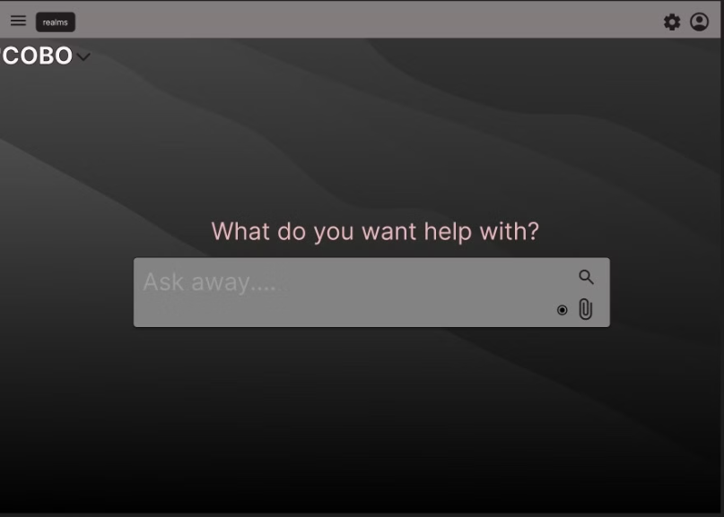
First User Interface Preview
A sneak peek at the intuitive design of Cobo AI, showcasing a user-friendly interface that simplifies complex workflows and enhances collaborative experiences.

Slide 6
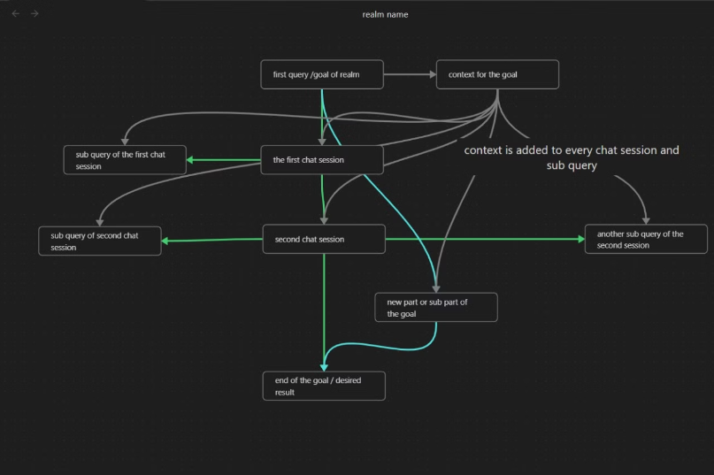
REALM View of Cobo AI
The Realm view offers a structured view of Cobo AI's capabilities. It provides a unique interface of the chat sessions. Cobo AI's realm view shows the users chats with LLM's in an interactive way. by clicking the specific chat user can go to the session with the LLM of thier choice whos results are mapped in the realm view and evolves as per user activity in the sapce.

Slide 7





CORE STRENGTHS
Intuitive User Interface (UI)
Large Context Windows
Personalized AI
Collaborative Tool
Environments for in-depth discussions.
AI insights tailored for you.
Teamwork and shared understanding.
Easy to use for all users.
Interactive Workflow
Dynamic engagement fostering innovation.

Slide 8



CHALLENGES AND THEIR SOLUTIONS
Market Fit
High Resource Demands
Complex Integration
Strategic integrations to ensure product-market fit.
Securing funding and employing lean development.
Focusing on core features and efficient computing.

Slide 9
FEATURES
The LLM summarizes previous sessions within the context window.
The space can also be used for regular, isolated queries by not connecting it to any sessions.
LLM-generated responses will be personalized, with subsequent responses tailored to the user's preferences based on past interactions.
Responses include source lists and double-checking for accuracy.

Slide 10
COBO AI offers a scalable solution to information overload by breaking down discussions and data into manageable context windows, maintaining a compressed, iterative workspace. Its intuitive design and mind map feature cater to visual learners and teams seeking clarity. The integrated code area is tailored for developers and data scientists, facilitating the translation of ideas into actionable code. The iterative workflow supports agile methodologies, making it ideal for startups and tech companies. Its broad applicability spans software development, education, business strategy, and creative fields.
WHY US ?

Slide 11



Slide 12

THANK YOU
We appreciate your time and consideration.
-Knowledge Knights Team

